Slide 1

Sentence Level Text Classification using Naïve Bayes
TEAM-6
BL.EN.U4AIE20031 – Kunisetty Jaswanth
BL.EN.U4AIE20032 – Masabattula Teja Nikhil
BL.EN.U4AIE20036 – Mutyala Sai Sri Siddhartha

Slide 2
Contents
Natural Language processing
Sentimental Analysis
Bayes Theorem
Word to Vector Representations
Libraries Used
Data Set
Implementation

Slide 3
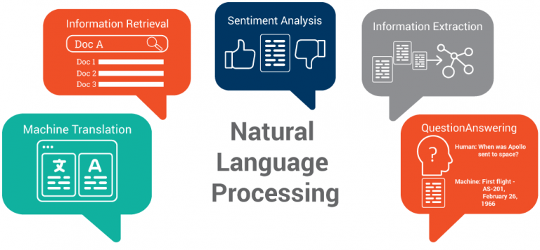
Natural Language Processing (NLP)
Natural Language Processing (NLP) aims to build machines that understand and respond to text or voice data—and respond with text or speech of their own—in much the same way humans do

Slide 4
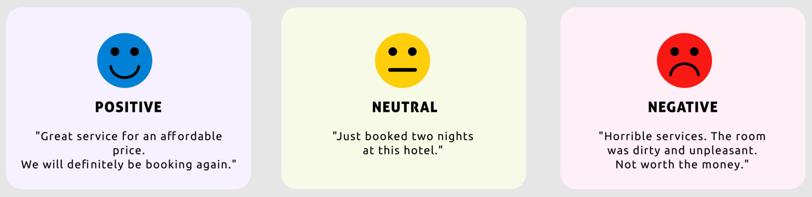
Sentimental Analysis
Sentiment analysis is like one of the problem statement of natural language processing
It has many applications in text analysis, computational linguistics, in bioinformatics to systematically identify, extract, quantify and study affective states and subjective

Slide 5
What is Text Classification
Sentimental analysis is an automated process capable of understanding the feelings, opinions that underlie a text
There are two levels of granularities in Text Classification:
Sentence level Classification
Document level Classification

Slide 6
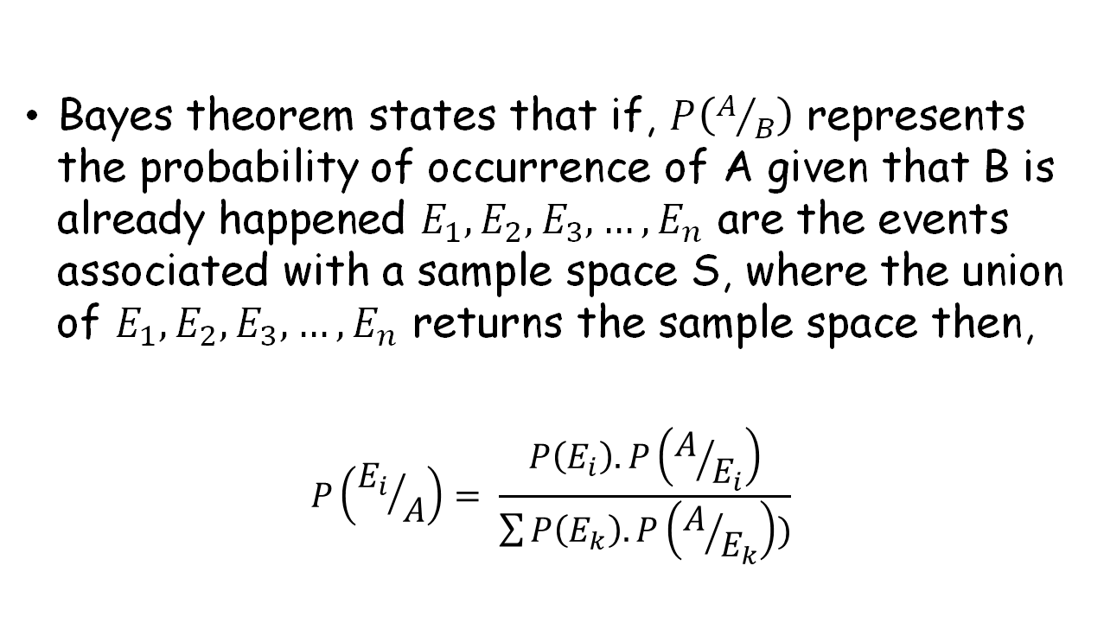
Bayes Theorem
Bayes theorem states that if, $P\left(A/B\right)$ represents the probability of occurrence of A given that B is already happened $E_{1},E_{2},E_{3},…, E_{n}$ are the events associated with a sample space S, where the union of $E_{1},E_{2},E_{3},…, E_{n}$ returns the sample space then,
$$P\left({E_{i}}/A\right)= \frac{P\left(E_{i}\right).P\left(A/{E_{i}}\right)}{\sum{P\left(E_{k}\right).P\left(A/{E_{k}}\right))}}$$

Slide 7
Word to Vector Representations
There are various methods of converting the word into a vectorized form which include
Bag-of-words
Word2vec
Frequency Count
Word Embeddings

Slide 8
Bag-of-words Representation
wow love place | 1
crust not good | 0
not tasti textur nasti | 0
wow | love | place | crust | not | good | tasti | textur | nasti | Labels
1 | 1 | 1 | 0 | 0 | 0 | 0 | 0 | 0 | 1
0 | 0 | 0 | 1 | 1 | 1 | 0 | 0 | 0 | 0
0 | 0 | 0 | 0 | 1 | 0 | 1 | 1 | 1 | 0

Slide 9
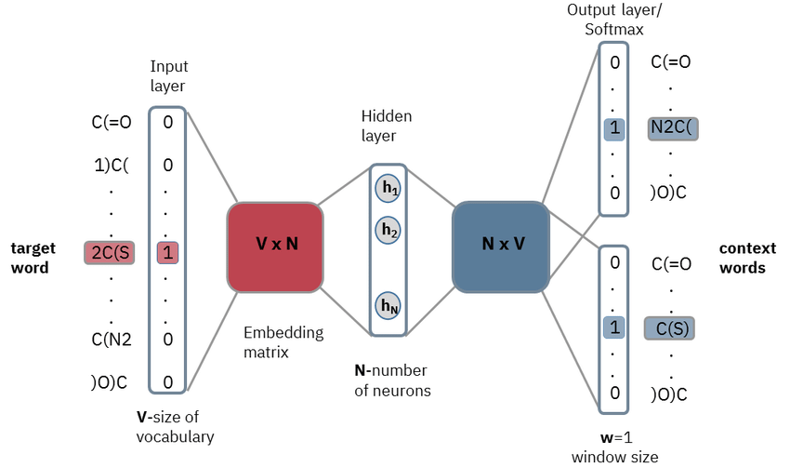
Word2Vec Representation

Slide 10
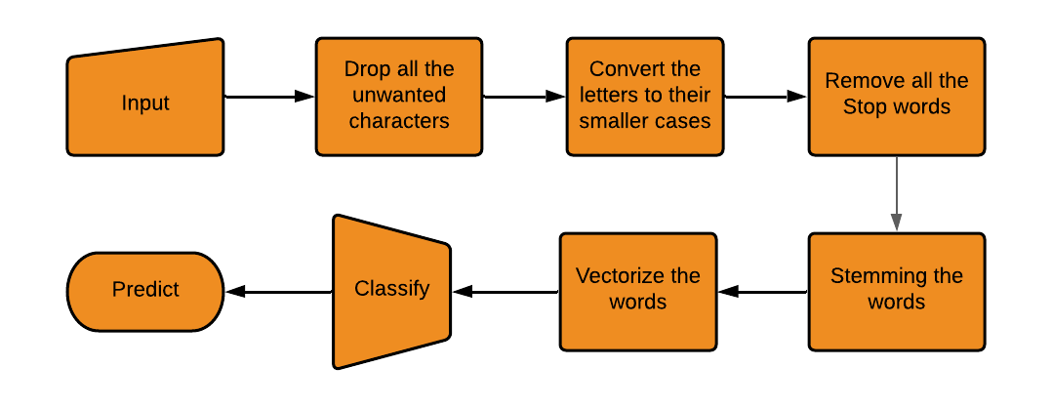
Block Diagram

Slide 11
Libraries Used
Pandas
NLTK
Porter stemmer
Count Vectorizer
GaussianNB
Matplotlib
Regular expressions (re)

Slide 12

IMPLEMTATION

Slide 13
THANK YOU

